Slide 1
6 - Introduction to electrochemical syntheses

Slide 2
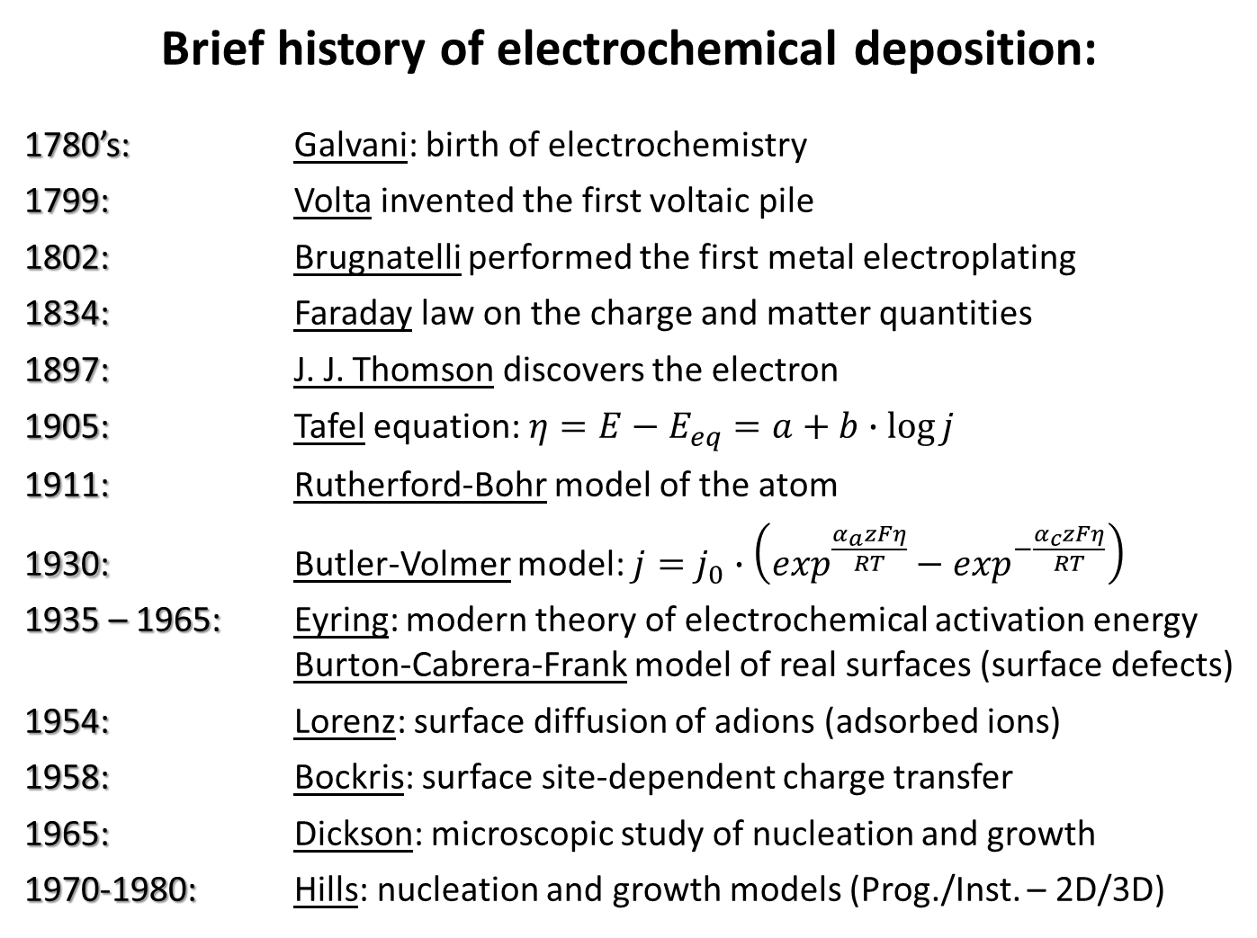
Brief history of electrochemical deposition:
1780’s: Galvani: birth of electrochemistry
1799: Volta invented the first voltaic pile
1802: Brugnatelli performed the first metal electroplating
1834: Faraday law on the charge and matter quantities
1897: J. J. Thomson discovers the electron
1905: Tafel equation: $η=E−E_{eq}=a+b∙\log{j}$
1911: Rutherford-Bohr model of the atom
1930: Butler-Volmer model: $j=j_{0}∙\left(\exp^{\frac{α_{a}zFη}{RT}}−\exp^{−\frac{α_{c}zFη}{RT}}\right)$
1935 – 1965: Eyring: modern theory of electrochemical activation energy
Burton-Cabrera-Frank model of real surfaces (surface defects)
1954: Lorenz: surface diffusion of adions (adsorbed ions)
1958: Bockris: surface site-dependent charge transfer
1965: Dickson: microscopic study of nucleation and growth
1970-1980: Hills: nucleation and growth models (Prog./Inst. – 2D/3D)

Slide 3
An important tool to process materials at the atomic scale:
Surface treatments
Separation and purification
Chemical synthesis
Additive manufacturing
Substrative manufacturing
Analyses (electrolytes and electrodes)
Electrochemical techniques can be classified as:
Substractive processes
Conversion processes
Additive processes
Analytical methods

Slide 4
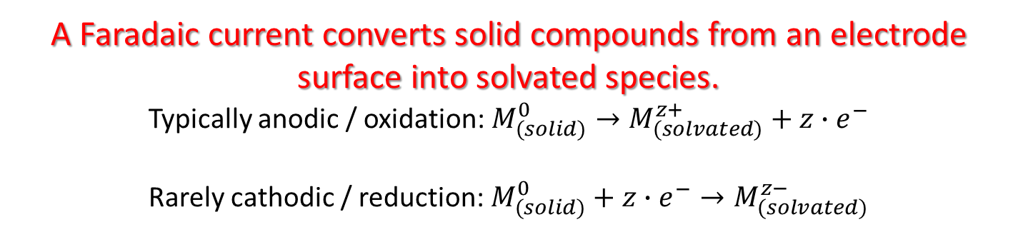
Substractive processes
Electrolytic dissolution
EC-induced dissolution
A Faradaic current converts solid compounds from an electrode surface into solvated species.
Typically anodic / oxidation: ${M_{(solid)}^{0}→M}_{(solvated)}^{z+}+{z∙e}^{−}$
Rarely cathodic / reduction: ${M_{(solid)}^{0}+{z∙e}^{−}→M}_{(solvated)}^{z−}$

Slide 5
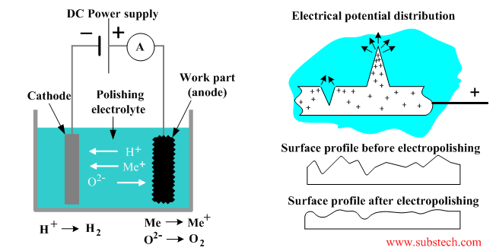
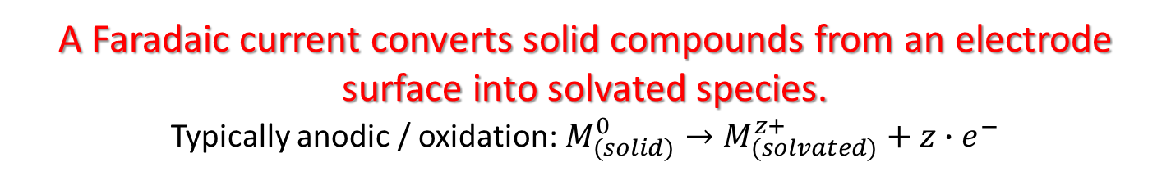
Substractive processes
Electrolytic dissolution
EC-induced dissolution
A Faradaic current converts solid compounds from an electrode surface into solvated species.
Typically anodic / oxidation: ${M_{(solid)}^{0}→M}_{(solvated)}^{z+}+{z∙e}^{−}$
Electropolishing
Applications: Electropolishing, electrochemical machining, electroleaching, dealloying, surface cleaning/activation

Slide 6
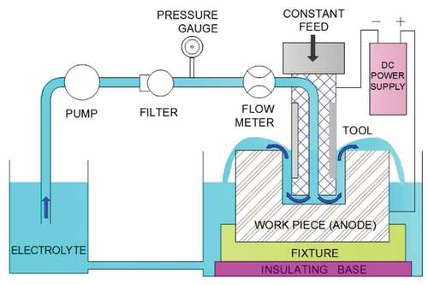
Substractive processes
Electrolytic dissolution
EC-induced dissolution
A Faradaic current converts solid compounds from an electrode surface into solvated species.
Typically anodic / oxidation: ${M_{(solid)}^{0}→M}_{(solvated)}^{z+}+{z∙e}^{−}$
Electrochemical machining
Applications: Electropolishing, electrochemical machining, electroleaching, dealloying, surface cleaning/activation

Slide 7
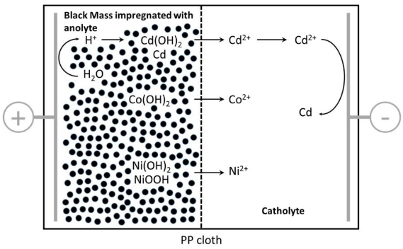
Substractive processes
Electrolytic dissolution
EC-induced dissolution
A Faradaic current converts solid compounds from an electrode surface into solvated species.
Typically anodic / oxidation: ${M_{(solid)}^{0}→M}_{(solvated)}^{z+}+{z∙e}^{−}$
Electroleaching
Applications: Electropolishing, electrochemical machining, electroleaching, dealloying, surface cleaning/activation

Slide 8
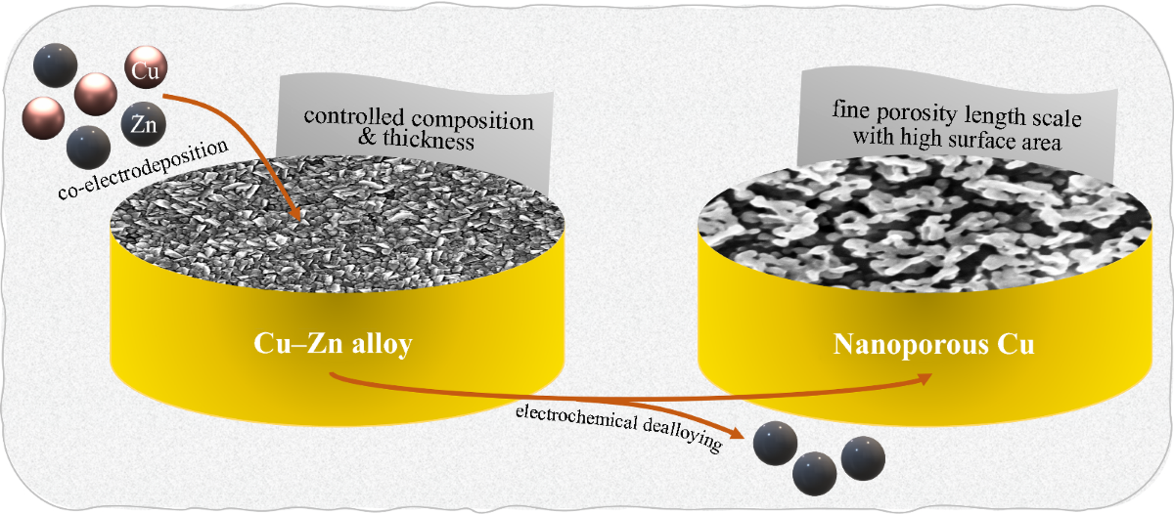
Substractive processes
Electrolytic dissolution
EC-induced dissolution
A Faradaic current converts solid compounds from an electrode surface into solvated species.
Typically anodic / oxidation: ${M_{(solid)}^{0}→M}_{(solvated)}^{z+}+{z∙e}^{−}$
Dealloying
Applications: Electropolishing, electrochemical machining, electroleaching, dealloying, surface cleaning/activation

Slide 9
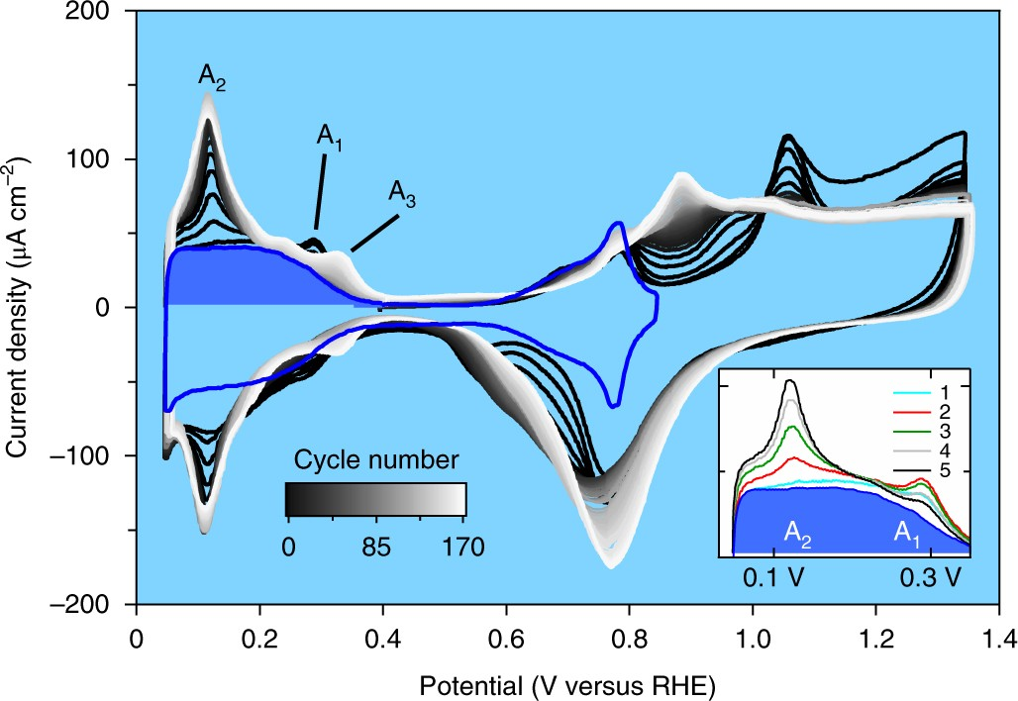
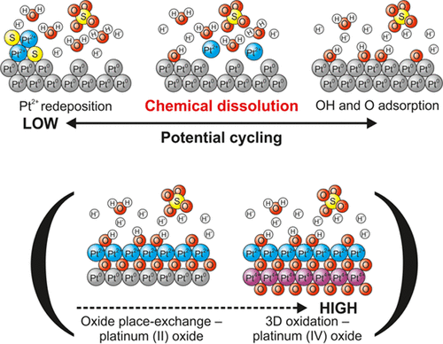
Substractive processes
Electrolytic dissolution
EC-induced dissolution
A Faradaic current converts solid compounds from an electrode surface into solvated species.
Typically anodic / oxidation: ${M_{(solid)}^{0}→M}_{(solvated)}^{z+}+{z∙e}^{−}$
Cleaning and activation of surfaces
Red/Ox of contaminants
Surface restructuring
Applications: Electropolishing, electrochemical machining, electroleaching, dealloying, surface cleaning/activation

Slide 10
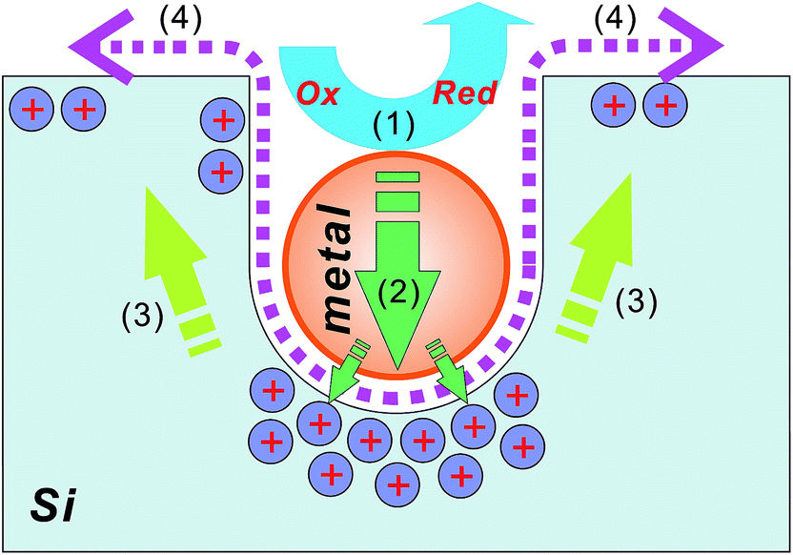
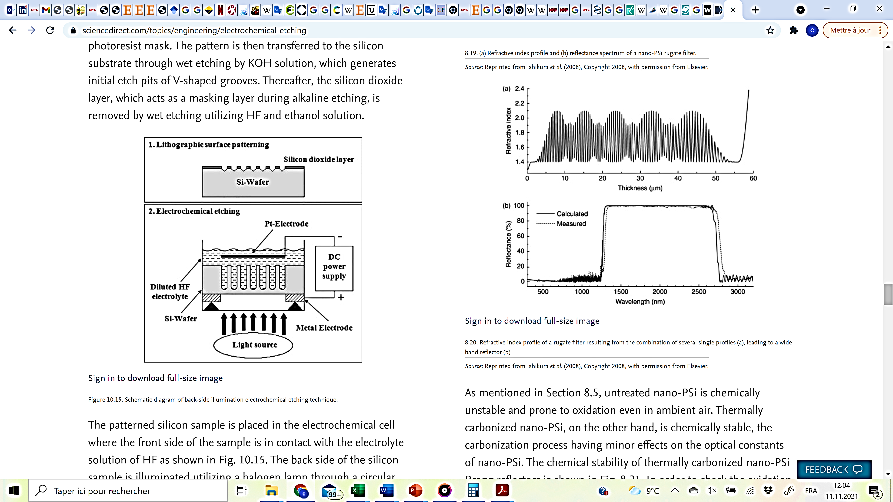
Substractive processes
Electrolytic dissolution
EC-induced dissolution
Electrochemical reactions induce local changes of chemical conditions leading to the dissolution of solid species.
Electrochemical etching of silicon
e.g., H₂O₂ reduction on silver particles
Applications: Silicon microcomponents and surface nanostructuring,
surface cleaning

Slide 11
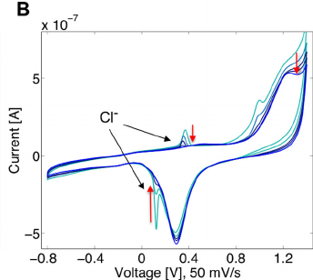
Substractive processes
Electrolytic dissolution
EC-induced dissolution
Electrochemical reactions induce local changes of chemical conditions leading to the dissolution of solid species.
Cleaning and activation of surfaces
Desorption
adsorption
Reactive radicals
desorption
Applications: Silicon microcomponents and surface nanostructuring,
surface cleaning

Slide 12
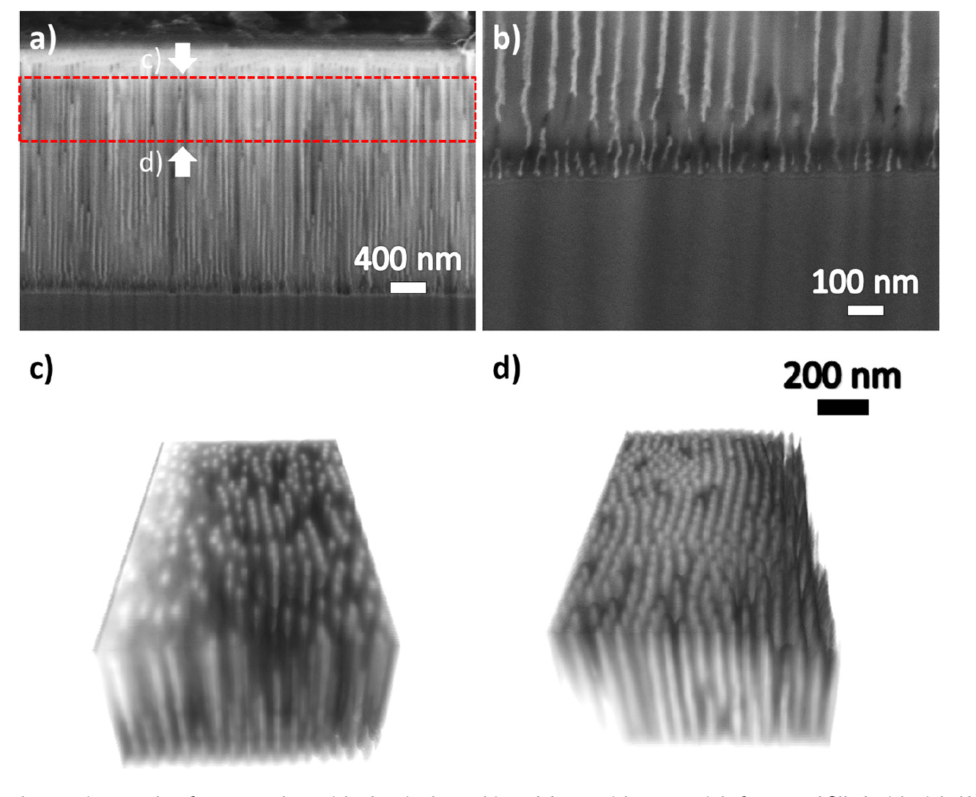
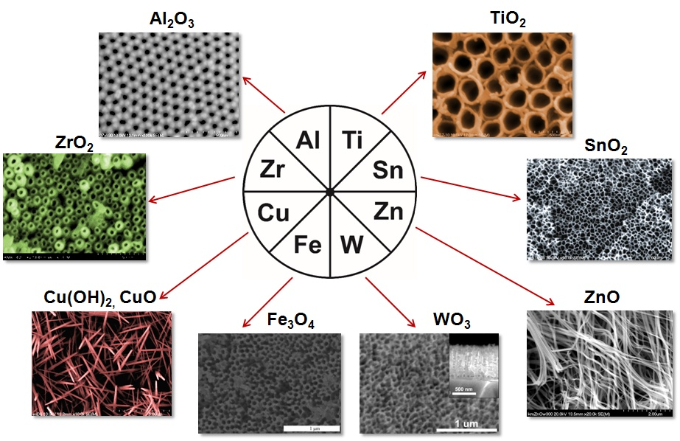
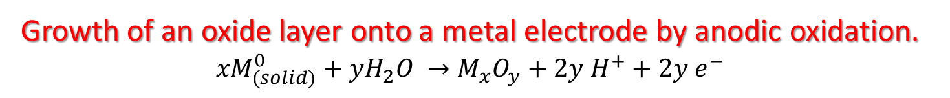
Conversion processes
Anodisation
Electrosynthesis
Energy conversion and storage
Ion transfer
Growth of an oxide layer onto a metal electrode by anodic oxidation.
$${xM}_{(solid)}^{0}+{yH}_{2}O →M_{x}O_{y}+2y{ H}^{+}+2y e^{−}$$
Anodic coatings
Anodisation of aluminum
Other examples
Highly ordered nanopore arrays
Applications: Protective coatings, nanoporous oxides, decorative, tribology, nanostructures

Slide 13
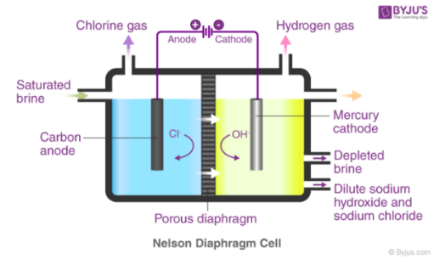
Conversion processes
Anodisation
Electrosynthesis
Energy conversion and storage
Ion transfer
Chemical transformation where electrodes are used to assist electron transfer reactions.
Anodic, cathodic, EC & C coupled reactions
Electrosynthesis of NaOH
Applications: Synthesis of added-value products (acids & bases, energy vectors, organics)

Slide 14
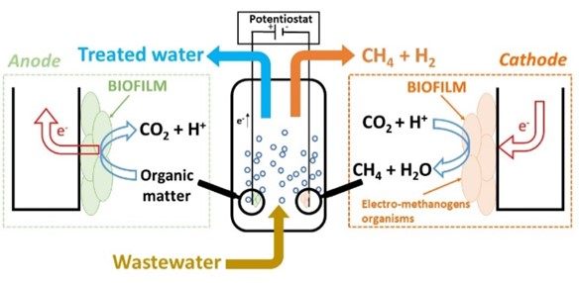
Conversion processes
Anodisation
Electrosynthesis
Energy conversion and storage
Ion transfer
Chemical transformation where electrodes are used to assist electron transfer reactions.
Anodic, cathodic, EC & C coupled reactions
Bioelectrolysis cells
Applications: Synthesis of added-value products (acids & bases, energy vectors, organics)

Slide 15
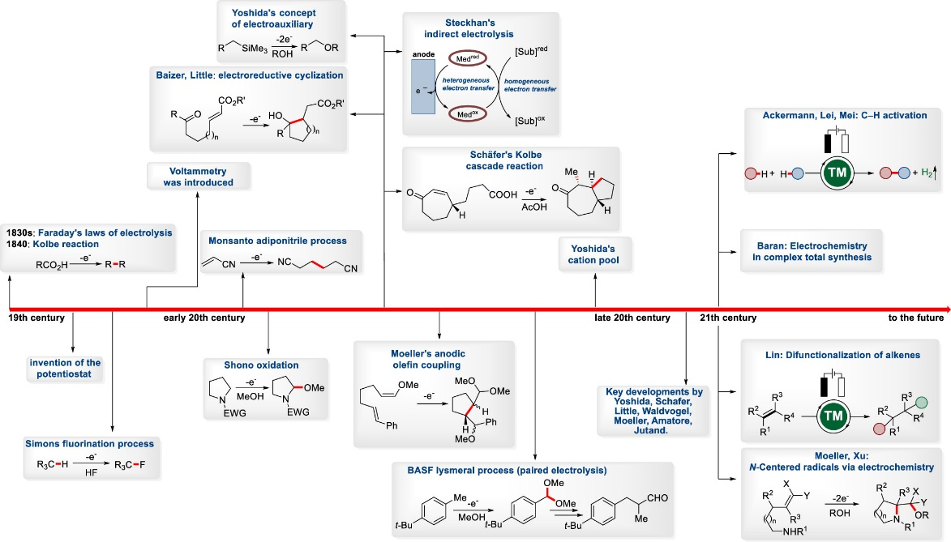
Conversion processes
Anodisation
Electrosynthesis
Energy conversion and storage
Ion transfer
Chemical transformation where electrodes are used to assist electron transfer reactions.
Anodic, cathodic, EC & C coupled reactions
Organic electrochemistry
Applications: Synthesis of added-value products (acids & bases, energy vectors, organics)

Slide 16
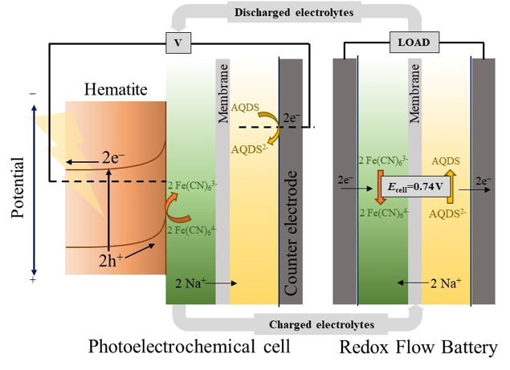
Conversion processes
Anodisation
Electrosynthesis
Energy conversion and storage
Ion transfer
Conversion of chemical potential into electrical energy and vice versa.
Anodic + cathodic, photons, phonons
Photoelectrochemical redox flow battery
Applications: Batteries, fuel cells, redox flow, light and heat harvesting, synthetic fuels

Slide 17
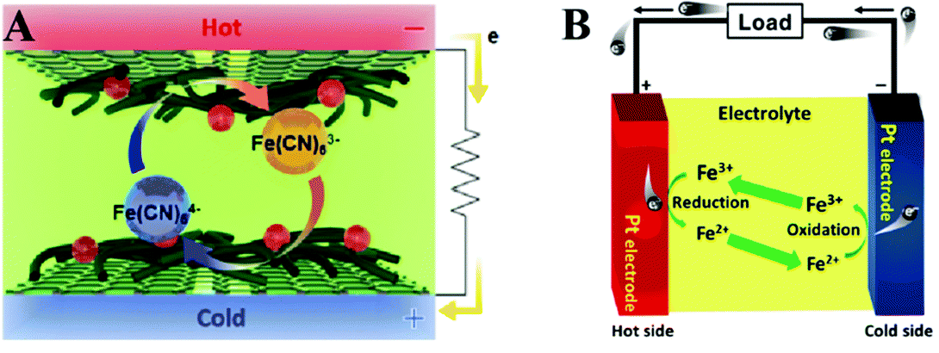
Conversion processes
Anodisation
Electrosynthesis
Energy conversion and storage
Ion transfer
Conversion of chemical potential into electrical energy and vice versa.
Anodic + cathodic, photons, phonons
Thermoelectrochemical cells
Applications: Batteries, fuel cells, redox flow, light and heat harvesting, synthetic fuels

Slide 18
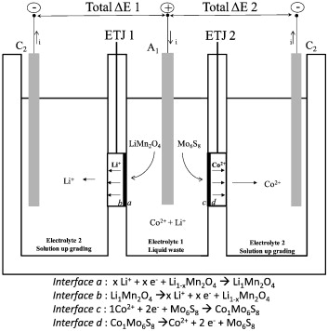
Conversion processes
Anodisation
Electrosynthesis
Energy conversion and storage
Ion transfer
Intercalation and extraction of ions.
Separation membrane
Electrochemical transfer junction
Applications: deionization, ion separation, waste treatment and recycling

Slide 19
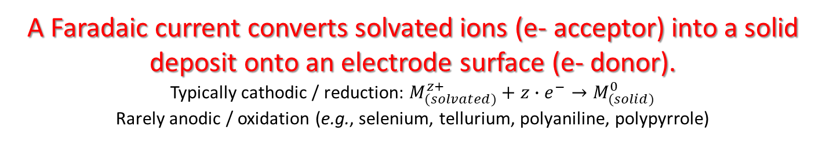
Additive processes
Electrolytic deposition
Electroless deposition
EC-induced precipitation
Electrophoretic deposition
A Faradaic current converts solvated ions (e- acceptor) into a solid deposit onto an electrode surface (e- donor).
Typically cathodic / reduction: $M_{(solvated)}^{z+}+{z∙e}^{−}→M_{(solid)}^{0}$
Rarely anodic / oxidation (e.g., selenium, tellurium, polyaniline, polypyrrole)
Cathodic deposition of copper
e⁻
All features must be electrically connected
Electrodeposit properties controlled by the electrolyte and electrode potential
WE
Cathode
CE
Anode
Cu
Cu
Cu²⁺+2e⁻
Cu²⁺+2e⁻
Applications: functional coatings (metals

Slide 20
Additive processes
Electrolytic deposition
Electroless deposition
EC-induced precipitation
Electrophoretic deposition
A Faradaic current converts solvated ions (e- acceptor) into a solid deposit onto an electrode surface (e- donor).
Typically cathodic / reduction: $M_{(solvated)}^{z+}+{z∙e}^{−}→M_{(solid)}^{0}$
Rarely anodic / oxidation (e.g., selenium, tellurium, polyaniline, polypyrrole)
Cathodic deposition of Bi₂Te₃
e⁻
All features must be electrically connected
Electrodeposit properties controlled by the electrolyte and electrode potential
WE
Cathode
CE
Anode
4H⁺ + 4e⁻ + O₂
Bi₂Te₃ + 6H₂O
2H₂O
2Bi³⁺ + 3HTeO₂⁺ + 18e⁻ + 9H⁺
Applications: functional coatings (metals, alloys, supersaturated solid solutions

Slide 21
Additive processes
Electrolytic deposition
Electroless deposition
EC-induced precipitation
Electrophoretic deposition
A Faradaic current converts solvated ions (e- acceptor) into a solid deposit onto an electrode surface (e- donor).
Typically cathodic / reduction: $M_{(solvated)}^{z+}+{z∙e}^{−}→M_{(solid)}^{0}$
Rarely anodic / oxidation (e.g., selenium, tellurium, polyaniline, polypyrrole)
Electropolymerization
e⁻
All features must be electrically connected
Electrodeposit properties controlled by the electrolyte and electrode potential
CE
Cathode
WE
Anode
NH
H₂
n
+ 2nH⁺ + 2ne⁻
Conductive polymers:
polyaniline, polypyrrole, polyfuran
→ Protective coatings, supercaps …
2e⁻ + 2H⁺
n
NH₃
Applications: functional coatings (metals, alloys, supersaturated solid solutions, polymers)

Slide 22
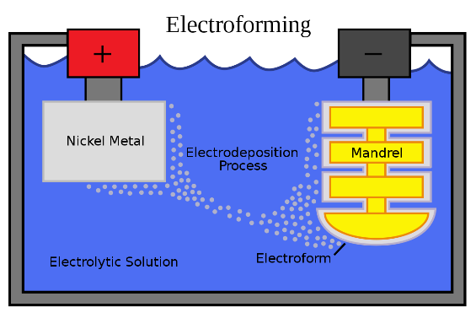

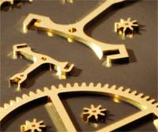
Additive processes
Electrolytic deposition
Electroless deposition
EC-induced precipitation
Electrophoretic deposition
A Faradaic current converts solvated ions (e- acceptor) into a solid deposit onto an electrode surface (e- donor).
Typically cathodic / reduction: $M_{(solvated)}^{z+}+{z∙e}^{−}→M_{(solid)}^{0}$
Rarely anodic / oxidation (e.g., selenium, tellurium, polyaniline, polypyrrole)
Electroforming
All features must be electrically connected
Electrodeposit properties controlled by the electrolyte and electrode potential
Electrodeposition is conformal
Applications: functional coatings (metals, alloys, supersaturated solid solutions, ceramics, polymers), surface texturing, 3D parts, microcomponents, nanostructures

Slide 23
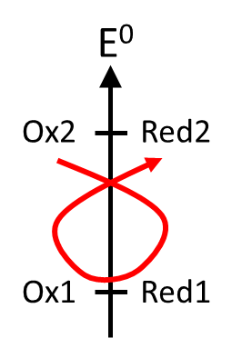
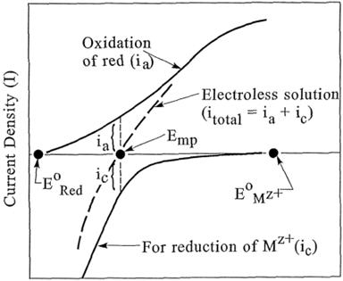

Additive processes
Electrolytic deposition
Electroless deposition
EC-induced precipitation
Electrophoretic deposition
Deposition is mediated by redox reactions between a reductant (e- donnor) and an oxidant (e- acceptor).
No external polarization needed, no counter electrode needed
Redox reaction
Driving force $∝ ∆E^{0}$
Applications: metallization of insulating parts, conformal coatings on complex geometries

Slide 24
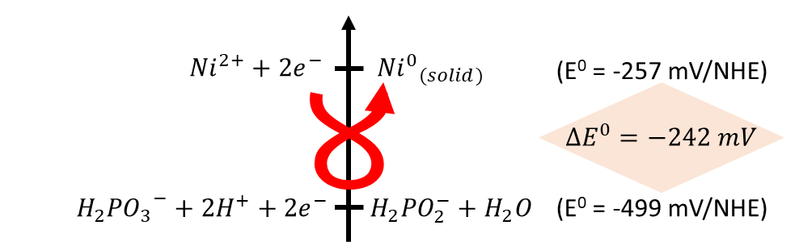
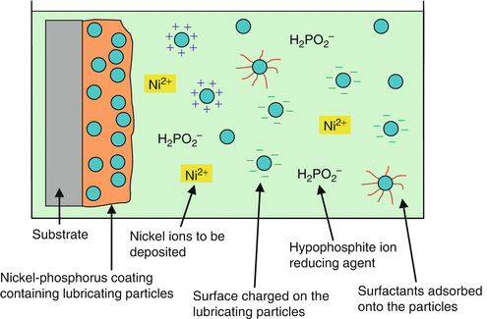
Additive processes
Electrolytic deposition
Electroless deposition
EC-induced precipitation
Electrophoretic deposition
Deposition is mediated by redox reactions between a reductant (e- donnor) and an oxidant (e- acceptor).
No external polarization needed, no counter electrode needed
Autocatalytic plating
Red and Ox are both solvated species
Phosphorous is codeposited (amorphous)
Possible to incorporate particles (hardness, friction)
→ Used for hard amagnetic coatings
Applications: metallization of insulating parts, conformal coatings on complex geometries, modification of surface chemistry, nanocomposites

Slide 25
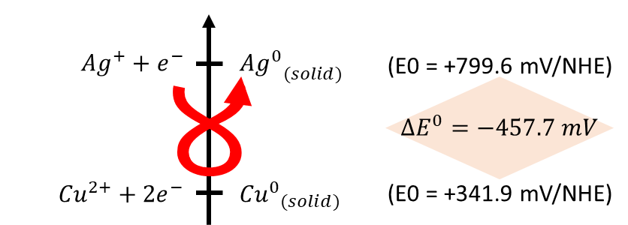
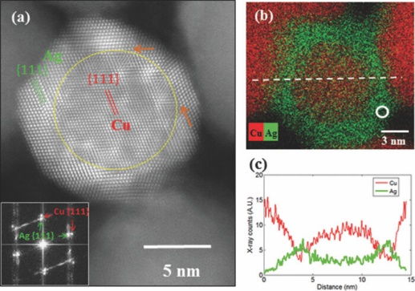
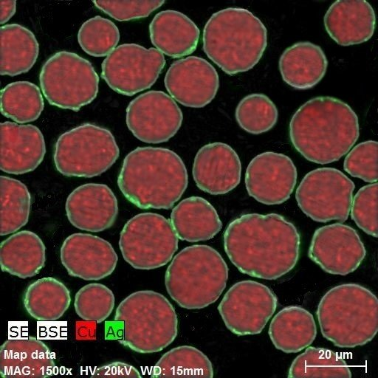
Additive processes
Electrolytic deposition
Electroless deposition
EC-induced precipitation
Electrophoretic deposition
Deposition is mediated by redox reactions between a reductant (e- donnor) and an oxidant (e- acceptor).
No external polarization needed, no counter electrode needed
Galvanic displacement
The reducting agent is the solid substrate
The most noble metal displaces the less noble metal
Self-limiting process
→ Modification of the surface chemistry, core-shell structures
Applications: metallization of insulating parts, conformal coatings on complex geometries, nanocomposites, corrosion and tarnishing protection, core-shell structures

Slide 26
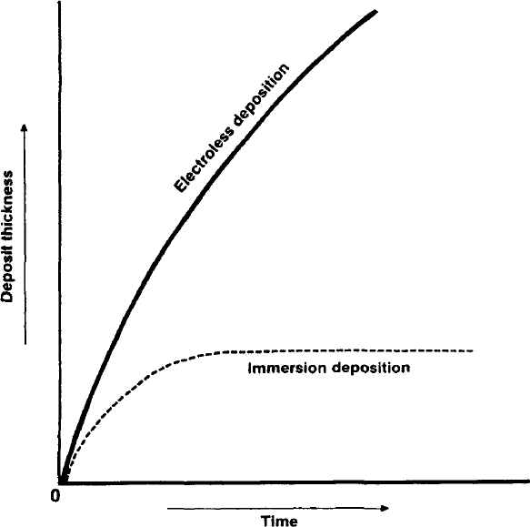
Additive processes
Electrolytic deposition
Electroless deposition
EC-induced precipitation
Electrophoretic deposition
Deposition is mediated by redox reactions between a reductant (e- donnor) and an oxidant (e- acceptor).
No external polarization needed, no counter electrode needed
Rate of electroless plating
Autocatalytic vs galvanic displacement
Autocatalytic plating:
The growth rate depends on the bath chemistry
Galvanic displacement:
The growth rate depends on the surface chemistry
Applications: metallization of insulating parts, conformal coatings on complex geometries, nanocomposites, corrosion and tarnishing protection, core-shell structures

Slide 27
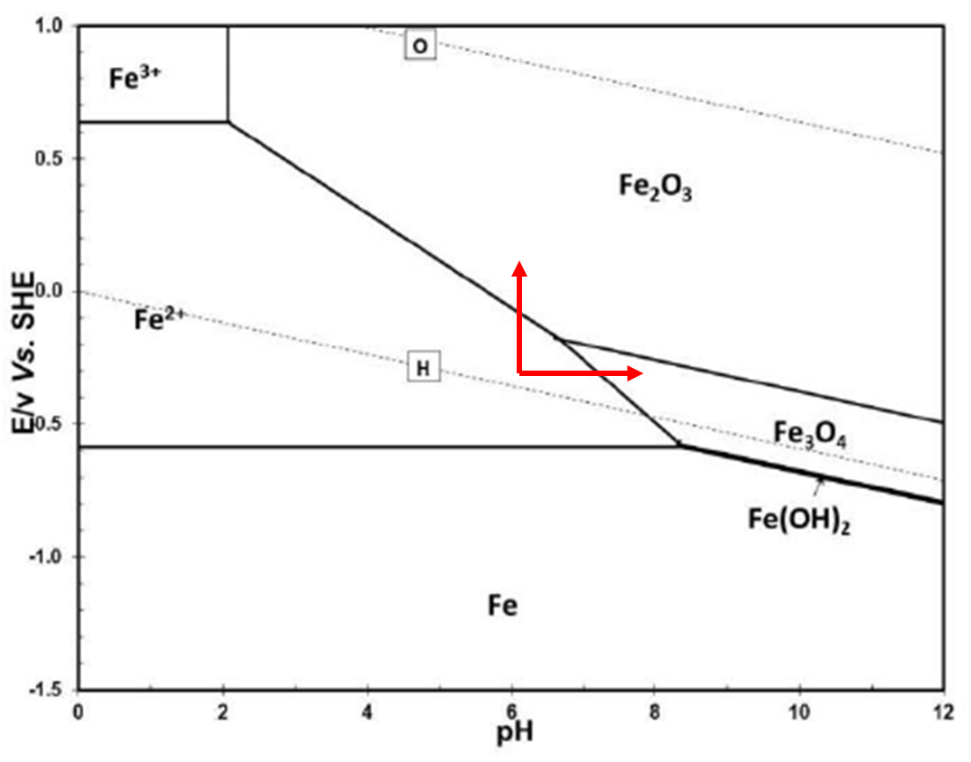
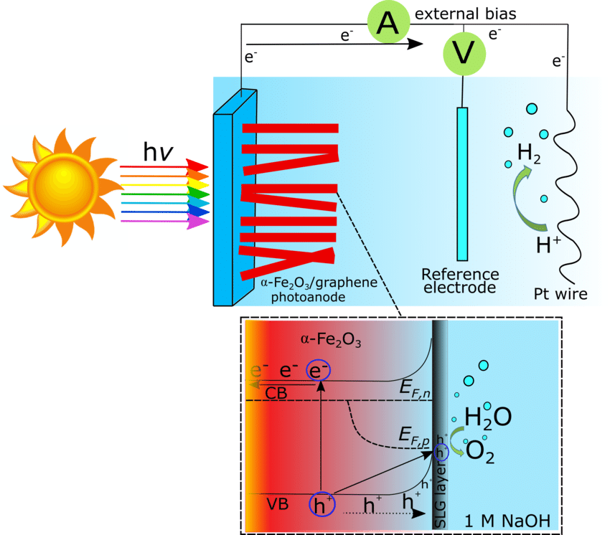

Additive processes
Electrolytic deposition
Electroless deposition
EC-induced precipitation
Electrophoretic deposition
Electrochemical reactions induce local changes of chemical conditions leading to the precipitation of solvated species.
A local increase of ionic strength leads to metal oxide/hydroxide precipitates.
Typically the pH but also the oxidation state or coordination
Three ways of precipitating Fe_{x}O_{y}
$$∽$$
Hematite photoelectrocatalyst decorated nanostructures for solar water splitting
Applications: electroplating of oxides, catalysis

Slide 28
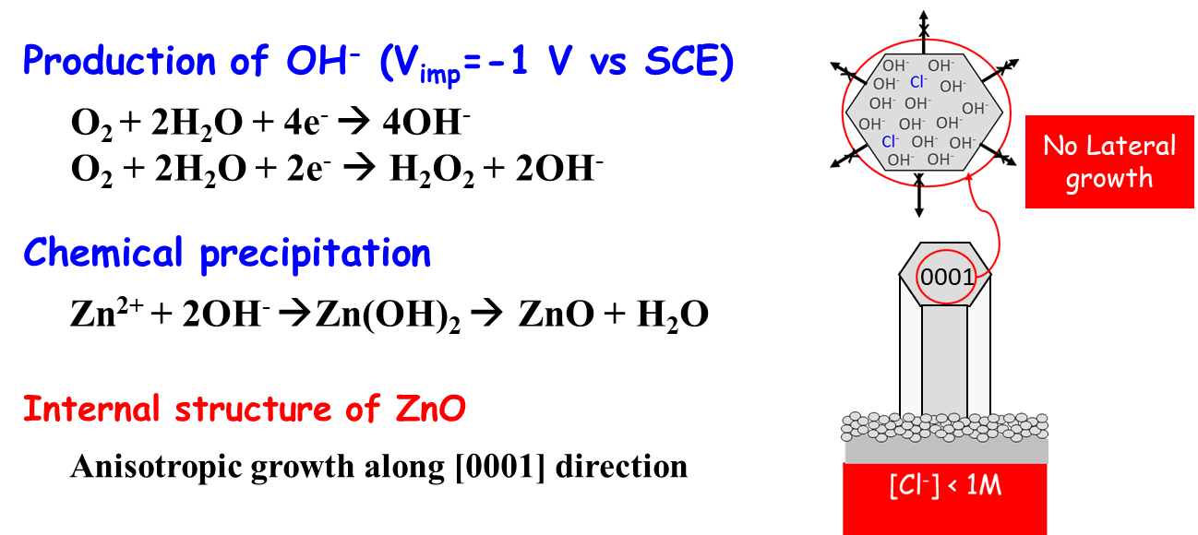
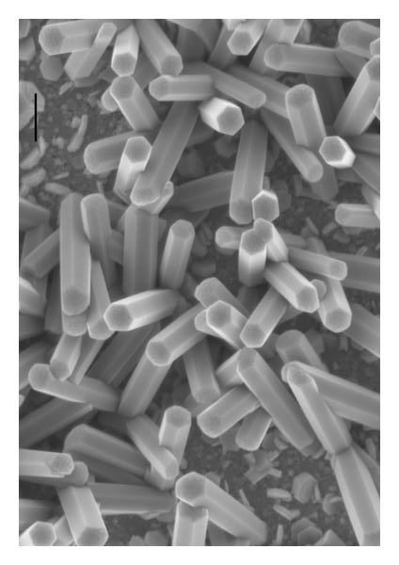
Additive processes
Electrolytic deposition
Electroless deposition
EC-induced precipitation
Electrophoretic deposition
Electrochemical reactions induce local changes of chemical conditions leading to the precipitation of solvated species.
A local increase of ionic strength leads to metal oxide/hydroxide precipitates.
Typically the pH but also the oxidation state or coordination
Precipitation of ZnO nanorods
Applications: electroplating of oxides, catalysis, functional coatings (photonics, hydrophobicity,

Slide 29
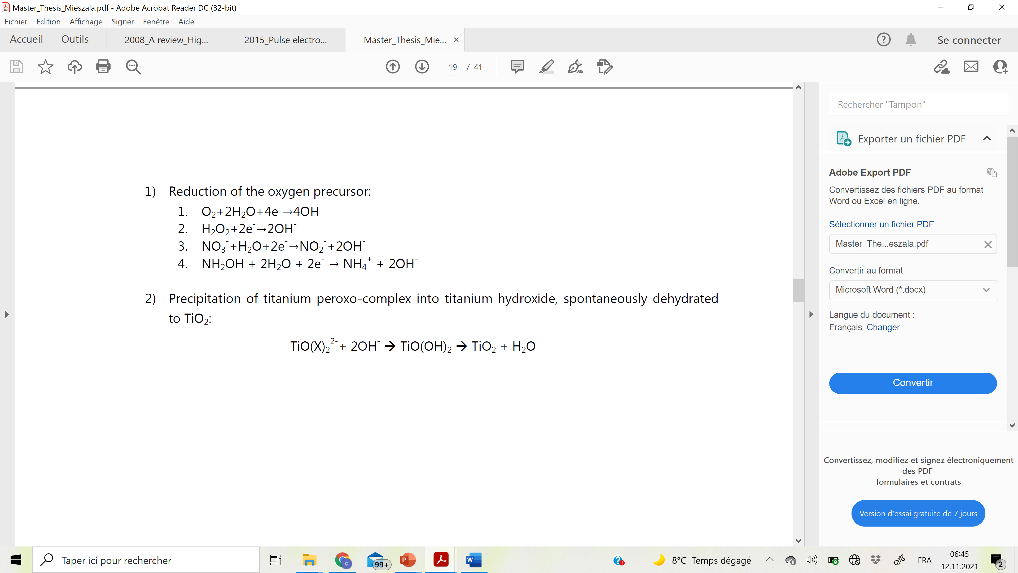
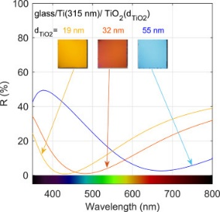
Additive processes
Electrolytic deposition
Electroless deposition
EC-induced precipitation
Electrophoretic deposition
Electrochemical reactions induce local changes of chemical conditions leading to the precipitation of solvated species.
A local increase of ionic strength leads to metal oxide/hydroxide precipitates.
Typically the pH but also the oxidation state or coordination
Precipitation of TiO₂ nanolayers
Interference colors
Applications: electroplating of oxides, catalysis, functional coatings (photonics, hydrophobicity, dichroic, biocompatibility…)

Slide 30
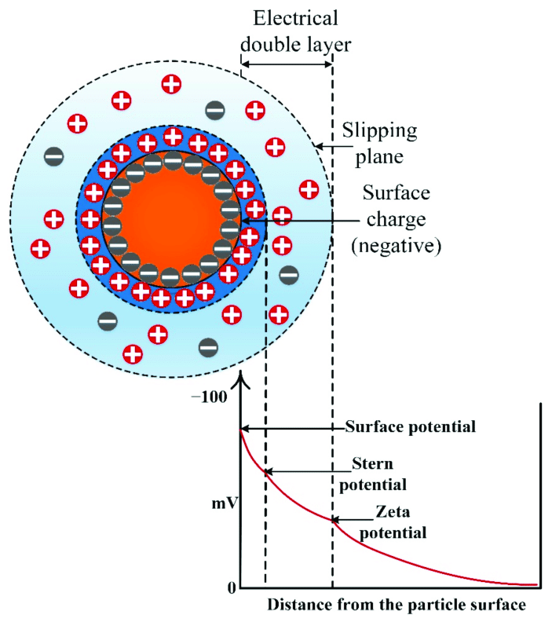
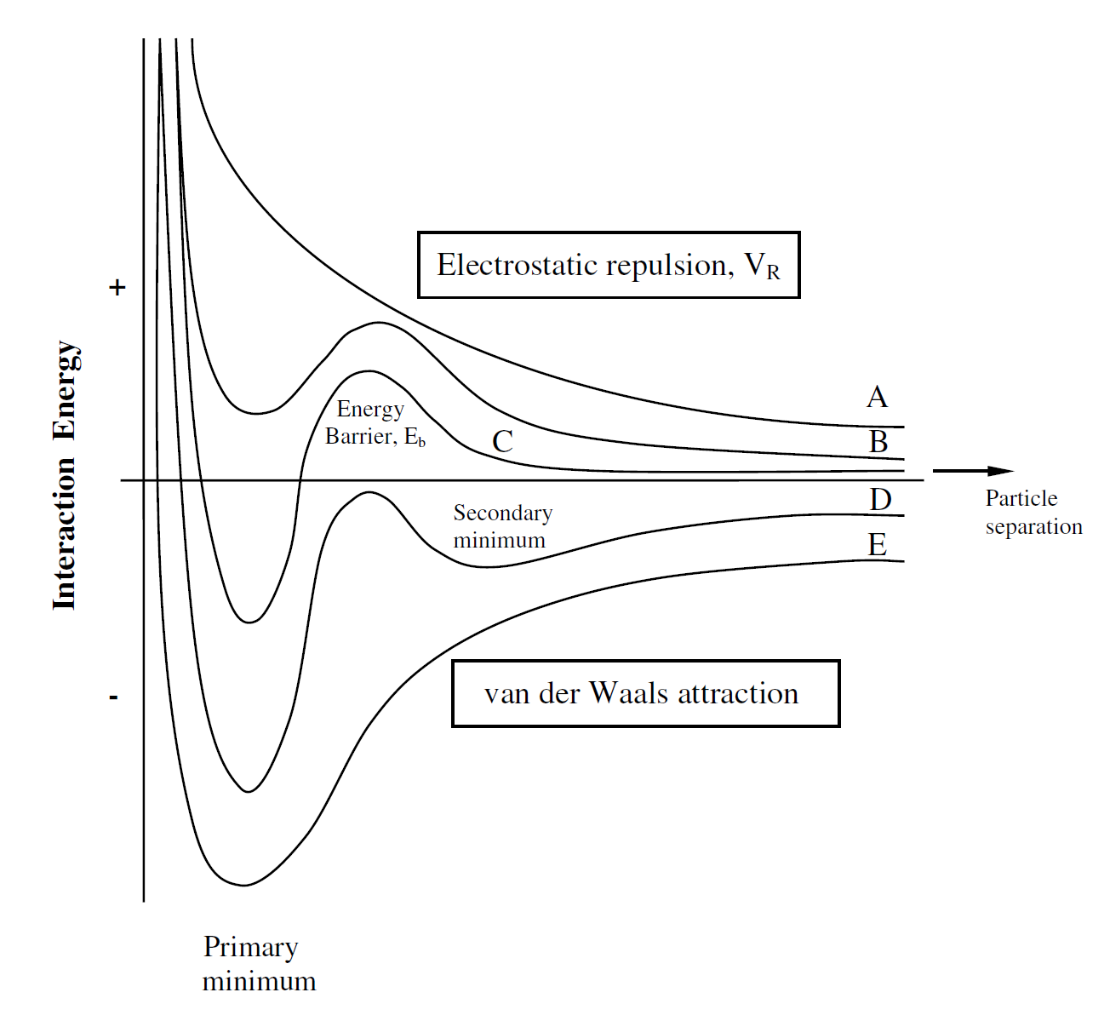



Additive processes
Electrolytic deposition
Electroless deposition
EC-induced precipitation
Electrophoretic deposition
Forced migration and desolvation of charged particles (colloids) in an electric field.
Charged particles dispersed in an electrolyte (low ionic conductivity)
Any material that can develop a surface charge (zeta-potential)
Charged particles and colloids: the DLVO theory
Energy barrier
EPD potential
$$\left|ζ\right|>60 mV$$
Too stable > no primary minimum
Electrostatic repulsion
$$|ζ|↗$$
Interaction energy
Particle distance
Van der Waals attraction
$$\left|ζ\right|<10 mV$$
Unstable dispersion
Secondary minimum
Reversible aggregation
Primary minimum
Irreversible aggregation
Applications: dielectric coatings

Slide 31
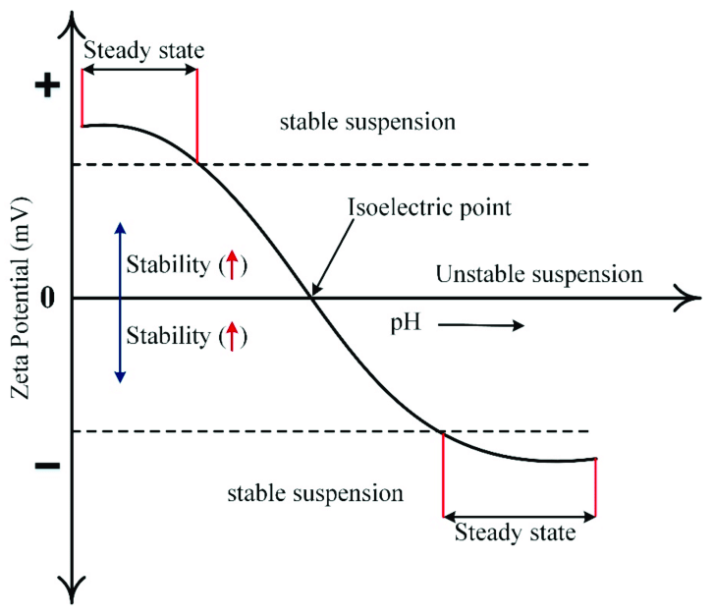
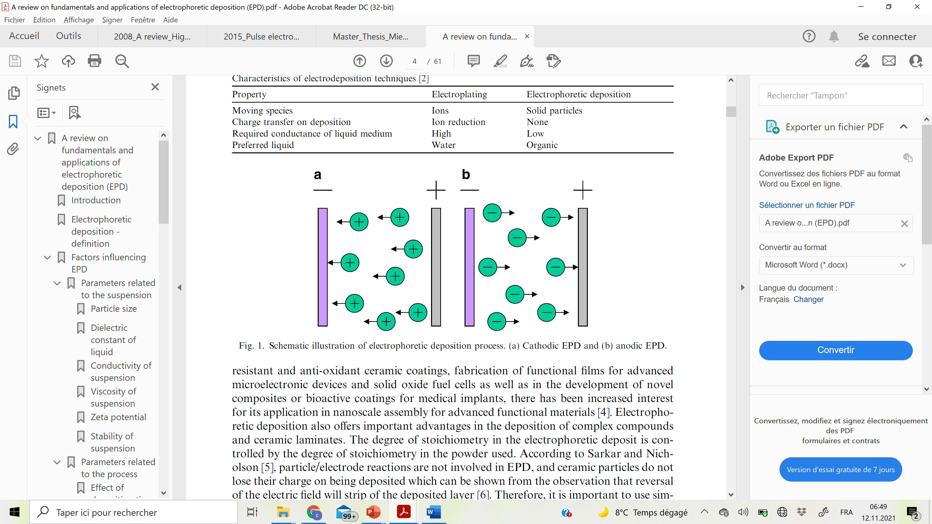
Additive processes
Electrolytic deposition
Electroless deposition
EC-induced precipitation
Electrophoretic deposition
Forced migration and desolvation of charged particles (colloïds) in an electric field.
Charged particles dispersed in an electrolyte (low ionic conductivity)
Any material that can develop a surface charge (zeta-potential)
Electrophoretic deposition: cathodic or anodic
Particles with ζ > 0 mV migrate towards the cathode
Cathodic EPD
Particles with ζ < 0 mV migrate towards the anode
Anodic EPD
Applications: dielectric coatings, paints, nanocomposite materials,
separation of colloids (by size or chemical nature)

Slide 32
Additive processes
Electrolytic deposition
Electroless deposition
EC-induced precipitation
Electrophoretic deposition
Forced migration and desolvation of charged particles (colloïds) in an electric field.
Charged particles dispersed in an electrolyte (low ionic conductivity)
Any material that can develop a surface charge (zeta-potential)
Electrophoretic vs electrolytic deposition
Property | Electroplating | Electrophoretic deposition
Moving species | Ions | Solid particles
Deposition mechanism | Charge transfer Electrocrystallization | Solvation sphere displacement Particle aggregation
Electrolyte conductivity | High | Low
Preferred solvent | Water | Organic solvents
Voltage | Few hundreds mV | Several tens V
Growth rate | < 50 µm/h | Hundreds of µm/h possible
Deposited materials | Only conductive materials | Any colloidal solid
Deposit morphology | Compact | Powder / need binding
Applications: dielectric coatings, paints, nanocomposite materials,
separation of colloids (by size or chemical nature)

Slide 33
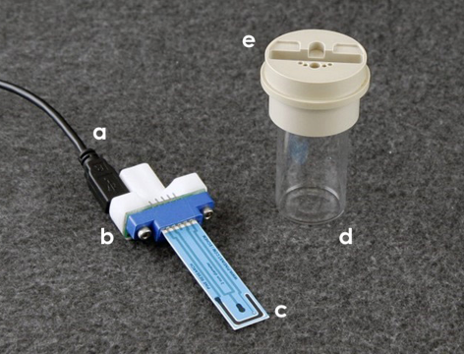
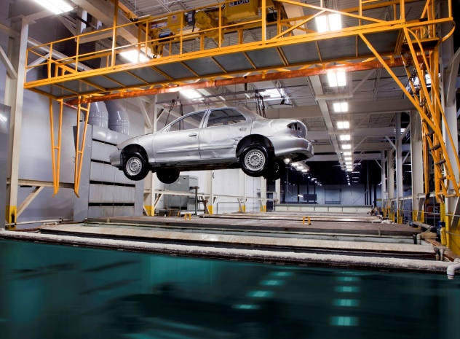
Applications of electrodeposition (electroplating)
Functional coatings, bulk materials, microcomponents, nanostructures, nanocomposites, and metamaterials
Advantages:
Versatility, ambient and near-ambient conditions
Relatively cheap and simple
Electrodeposits are conformal: possible to electroplate or electroform 3D parts
Electrodeposition only occurs on conductive surfaces: masking process/localized ECD
Possible to electrodeposit alloys and solid solution in a single step
Possible to electroplate complex materials (multilayers, nanocomposites…)
Easy to scale-up

Slide 34
Applications of electrodeposition (electroplating)
Functional coatings, bulk materials, microcomponents, nanostructures, nanocomposites, and metamaterials
Drawbacks:
Limited to conductive substrates
Sometime complex to get the desired coating properties
  Electrolyte formulation
  Physical parameters optimization
Chemical wastes might be hazardous
Medium growth rate (rarely more than several µm/h)

Slide 35
Applications of electrodeposition (electroplating)
Functional coatings, bulk materials, microcomponents, nanostructures, nanocomposites, and metamaterials
Materials selection:
Mechanical and tribological properties (e.g., hardness, wear resistance, friction)
Corrosion protection
Optical properties (reflectivity, colors (intrinsic, structural), metamaterials)
Electrical properties (semiconductors, electronic boards, MEMS)
Magnetic properties (diamagnetic, paramagnetic (…) gigantic magnetoresistance,)
(Photo-)(electro-)catalysts
Thermoelectric materials
Select the material for your application
→ can it be electrodeposited?

Slide 36
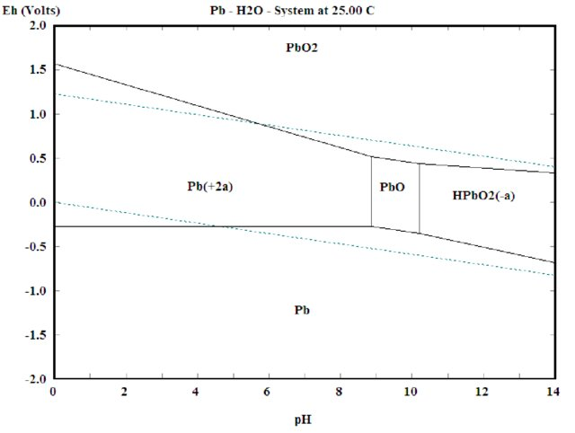
Applications of electrodeposition (electroplating)
What materials can be electrodeposited?
In aqueous electrolytes, one can refer to Pourbaix diagrams:
Thermodynamically stable phases = f(E, pH)
Example of Lead
pH < 8.8 or pH > 10.2

Slide 37
Applications of electrodeposition (electroplating)
What materials can be electrodeposited?
In aqueous electrolytes, one can refer to Pourbaix diagrams:
Thermodynamically stable phases = f(E, pH)
Example of Lead
Corrosion
ECD but with H₂ evolution
Electrodeposition
pH < 8.8 or pH > 10.2

Slide 38
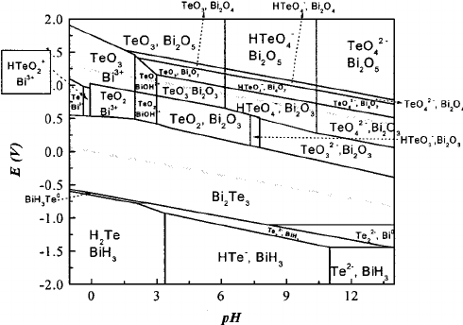
Applications of electrodeposition (electroplating)
What materials can be electrodeposited?
In aqueous electrolytes, one can refer to Pourbaix diagrams:
Thermodynamically stable phases = f(E, pH)
Example of Lead
Binary diagram – case of Bi₂Te₃
Corrosion
ECD but with H₂ evolution
Electrodeposition
pH < 8.8 or pH > 10.2

Slide 39
Applications of electrodeposition (electroplating)
What materials can be electrodeposited?
In aqueous electrolytes, one can refer to Pourbaix diagrams:
Thermodynamically stable phases = f(E, pH)
Example of Lead
Binary diagram – case of Bi₂Te₃
Corrosion
ECD but with H₂ evolution
Electrodeposition
pH < 8.8 or pH > 10.2
The more the elements the more the complexity
→ ECD window narrows

Slide 40
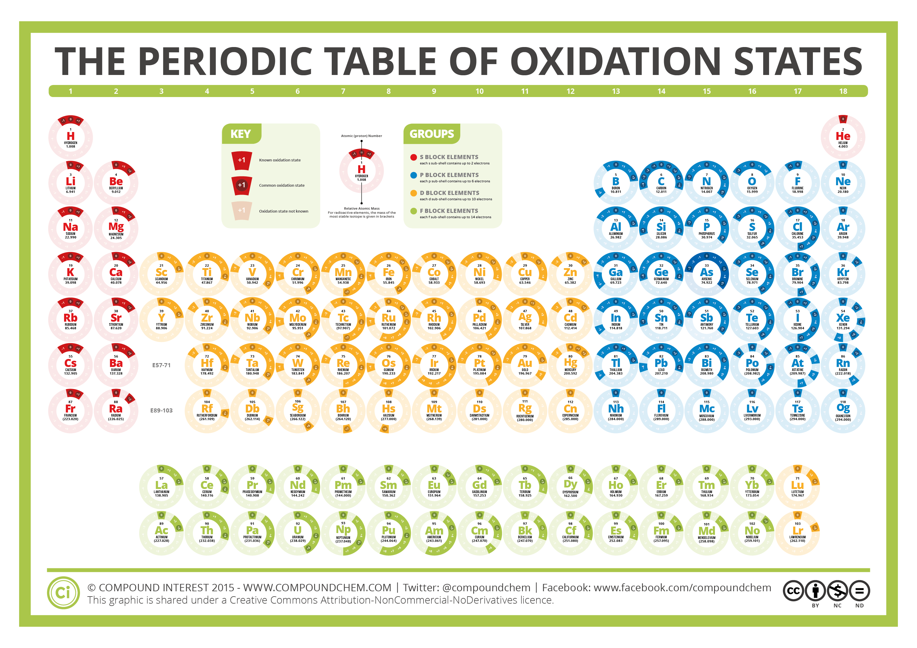
Applications of electrodeposition (electroplating)
What materials can be electrodeposited?

Slide 41
Applications of electrodeposition (electroplating)
What materials can be electrodeposited?
Electrodeposited from aqueous electrolytes
Transition metals, metals, semi-metals and metalloids

Slide 42
Applications of electrodeposition (electroplating)
What materials can be electrodeposited?
Molten salts, organic solvents, ionic liquids

Slide 43
Organisation of the lecture
Chapter 1: Atomistic and kinetic aspects of electrodeposition
Chapter 2: Nucleation and growth mechanisms, effect of ECD parameters
Chapter 3: Electrodeposition of alloys and solid solutions
Chapter 4: Template-assisted electrodeposition: from 3D parts to nanostructures

